Slide 1
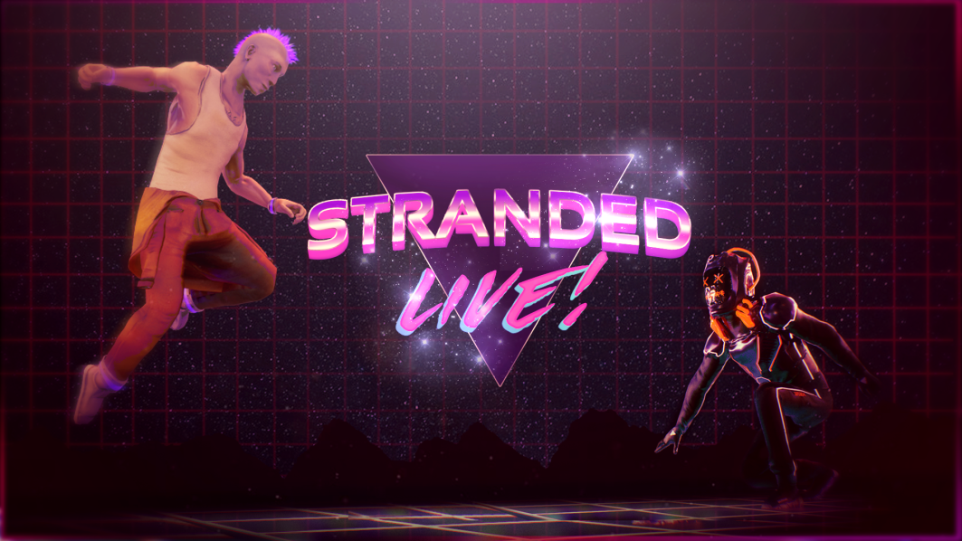

Broadcasting by:
Chris Rhodes, Lewis Bank, Brad Cullen, Reece Paranerd, Oliver Fayers, Daniel Lush & Luke Dicken-Jones

Slide 2
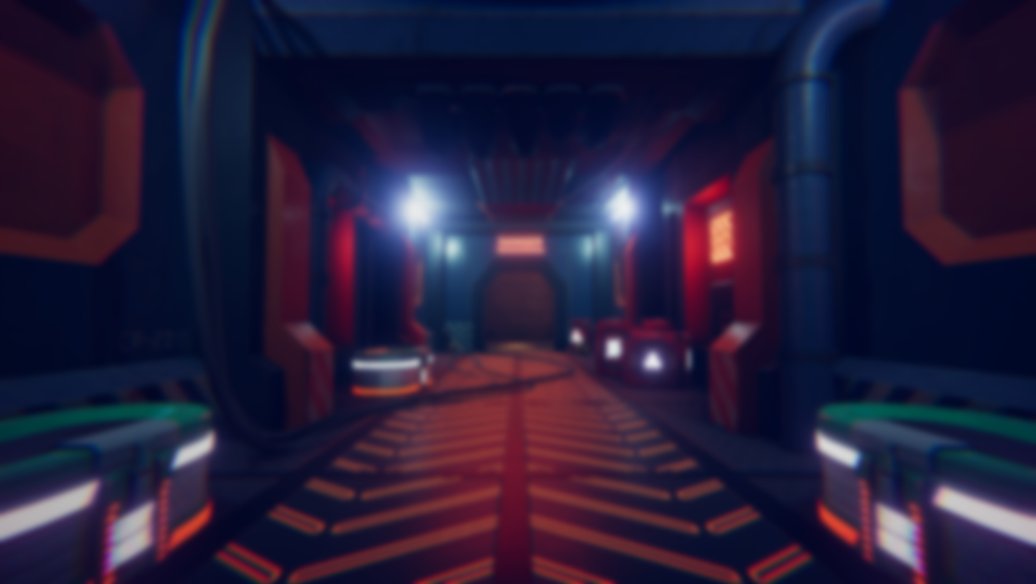
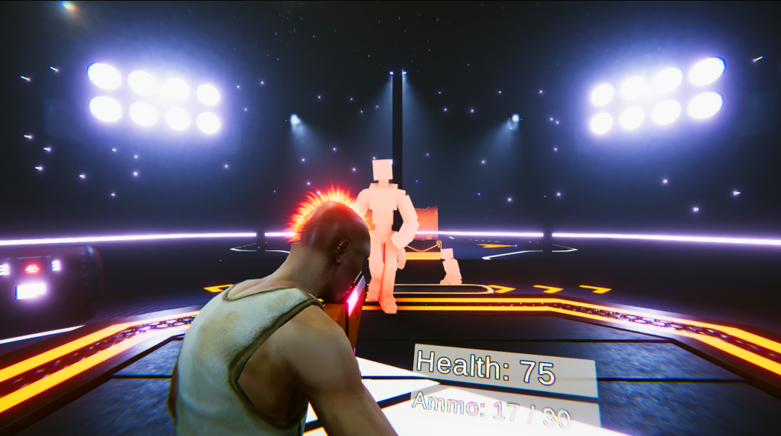
Stranded Live Overview
Destination: GalacTV broadcasting Space Station, Four prisoners are forced to fight for your entertainment as they fight waves of GalactTV’s System droids.
Work together, gain audience approval & get the best loot possible.
DON’T UPSET THE VIEWERS
ONLINE
Early – Unfinished build

Slide 3
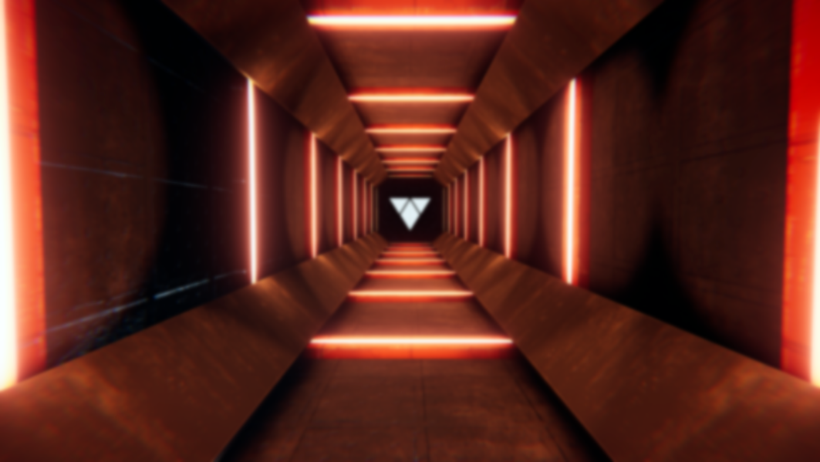
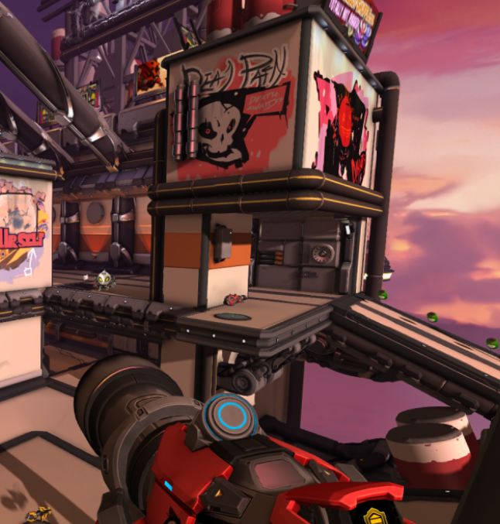
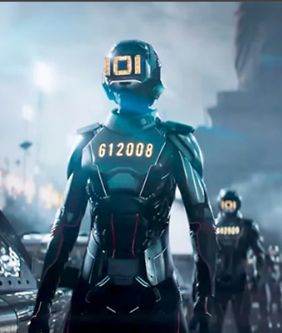
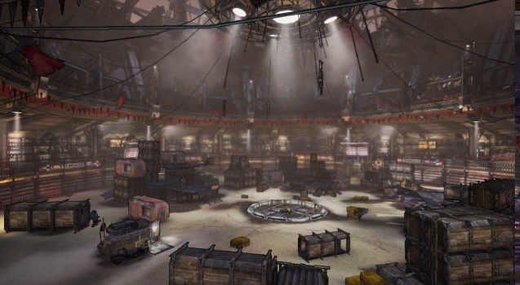
Pre Jam Prep
Before the jam started the team met three times to put forward ideas and discuss potential avenues of where the game can go.
Early on, the idea of doing an online game was suggested and we were really keen on the idea but understood the massive risk it would be to do within a games jam.
This pushed us to research and learn to see if its actually possible, as we needed to make sure it is scoped.

Slide 4
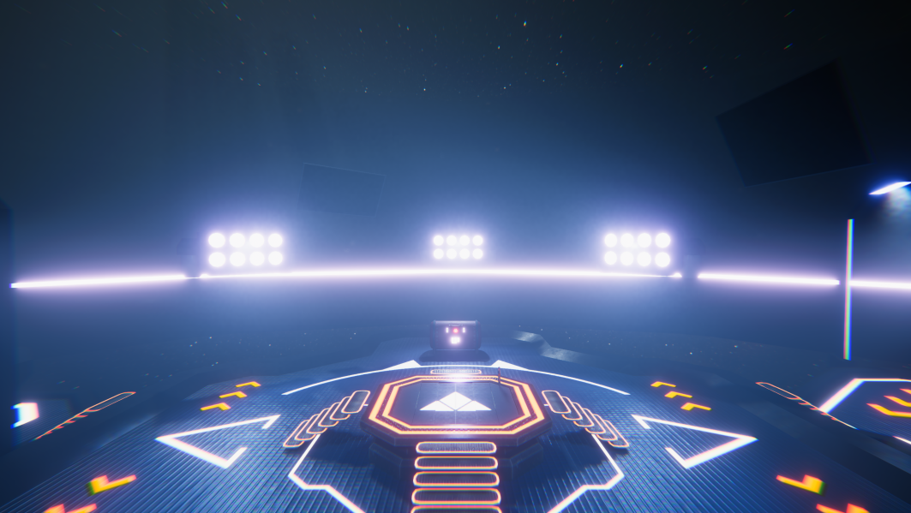










Software used

Slide 5
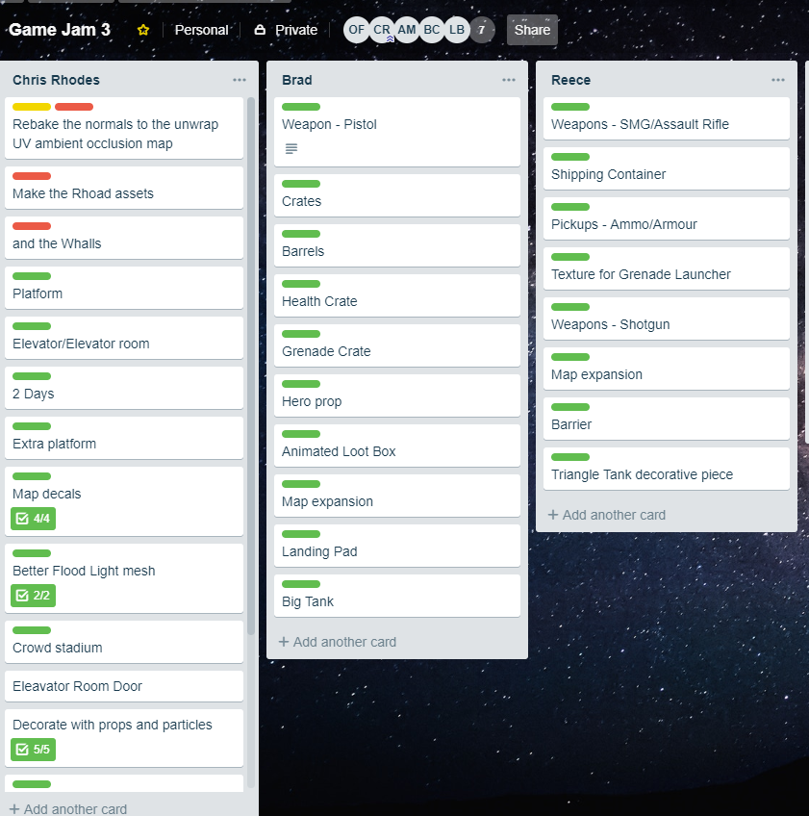
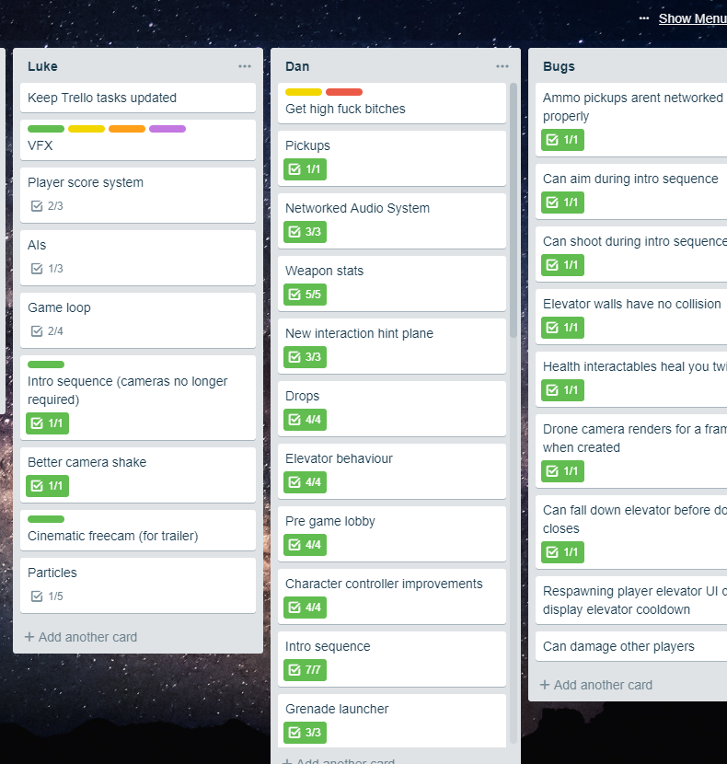
Trello

Slide 6
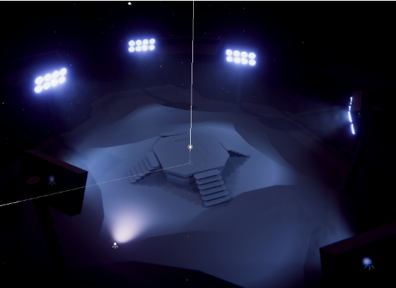
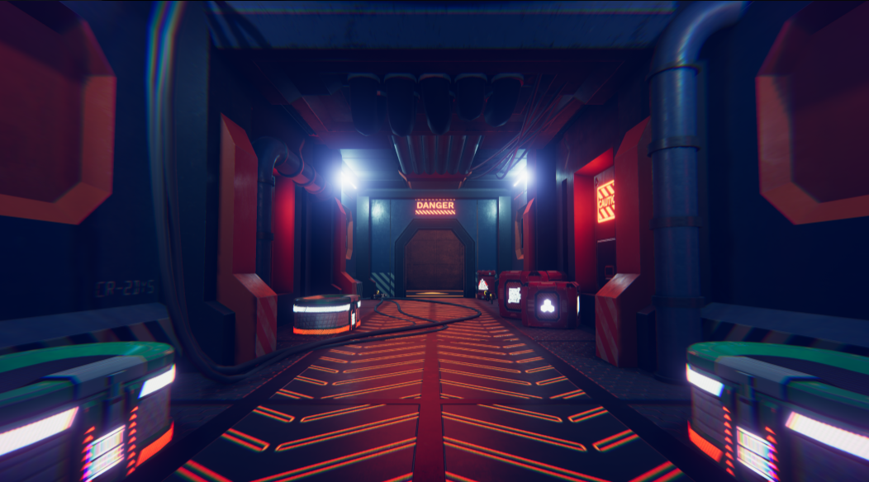
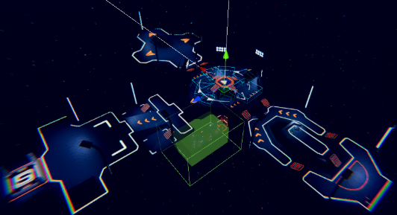
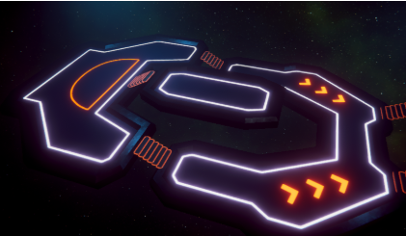
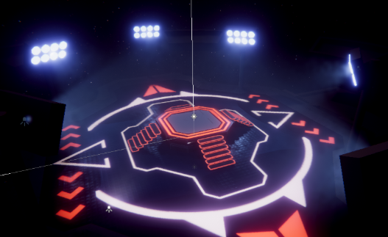
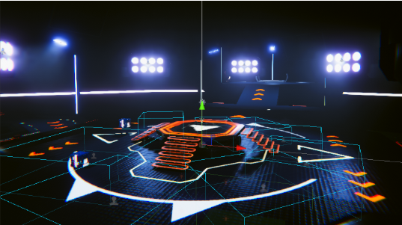
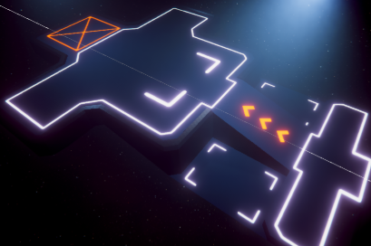
Level

Slide 7
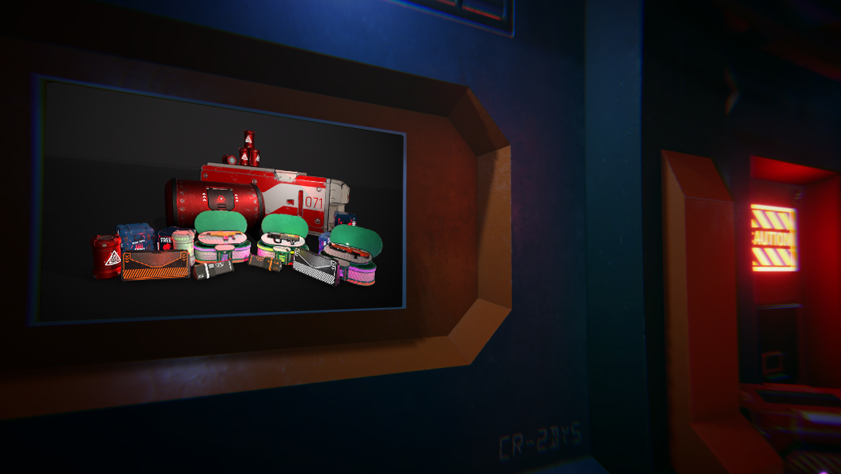
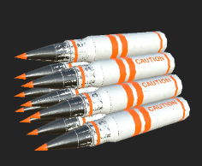
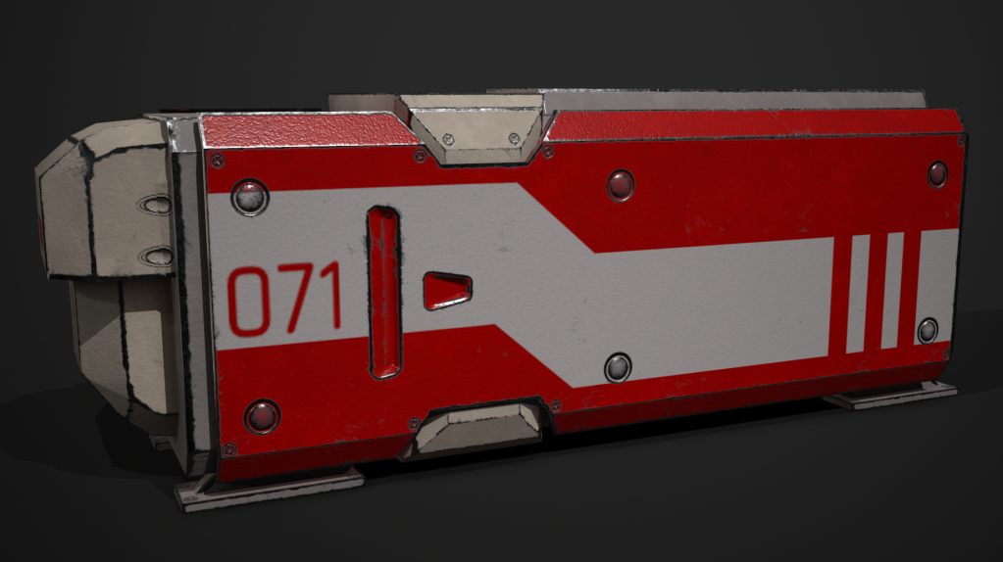
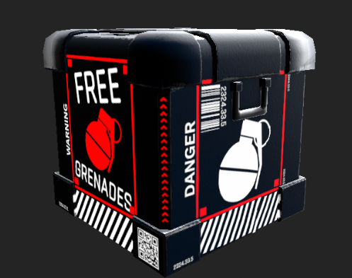
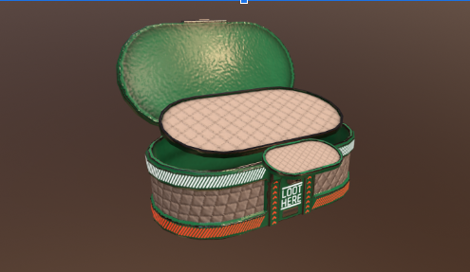
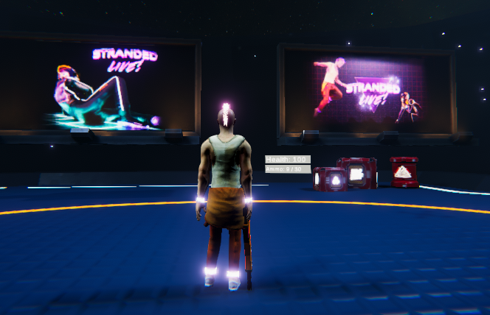

Assets

Slide 8
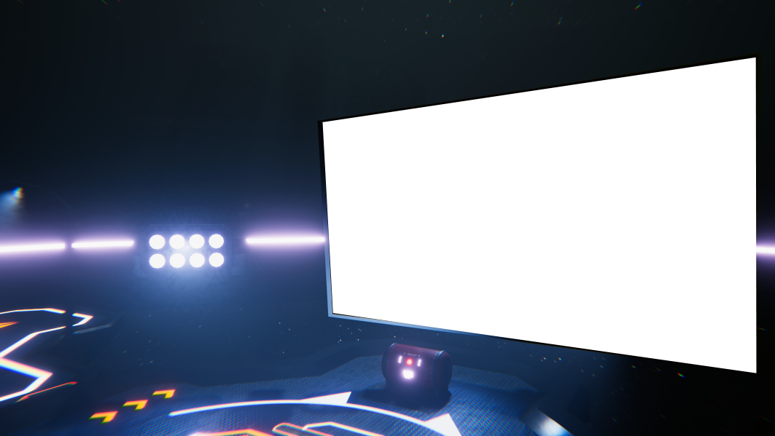


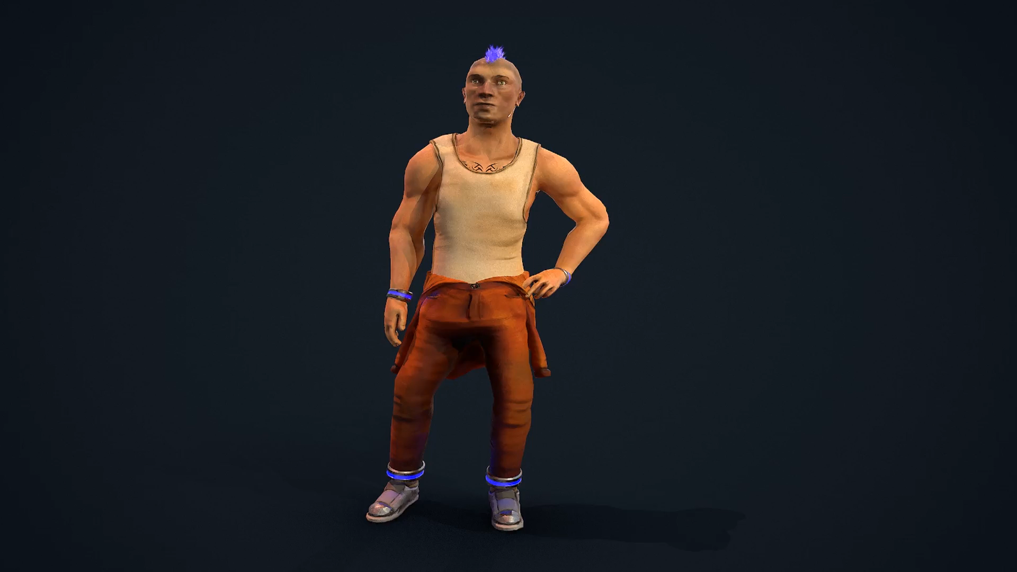

Player Character
Prisoner contestant
Glowhawk colour different for each player
11k tris
Final Model

Slide 9
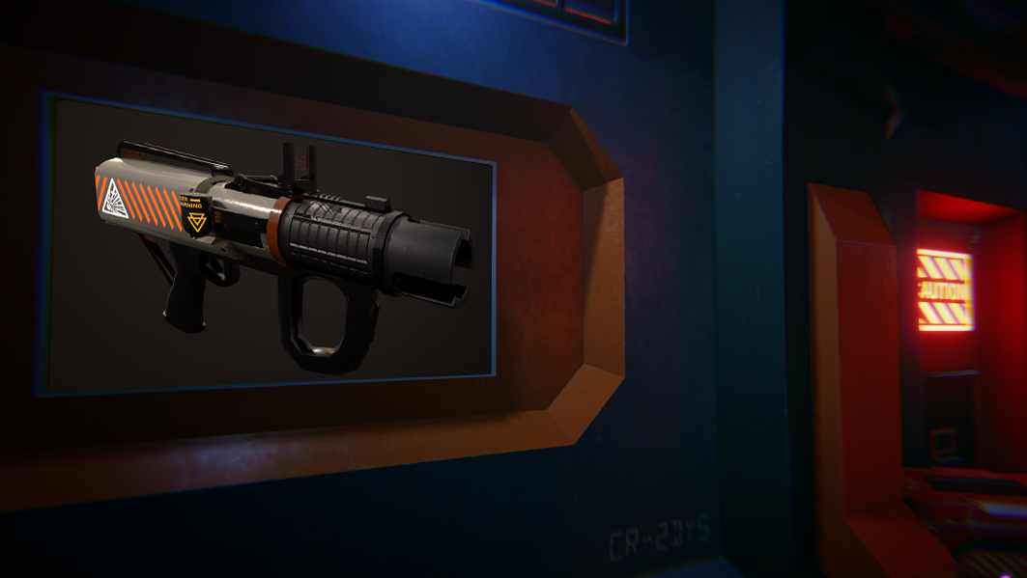
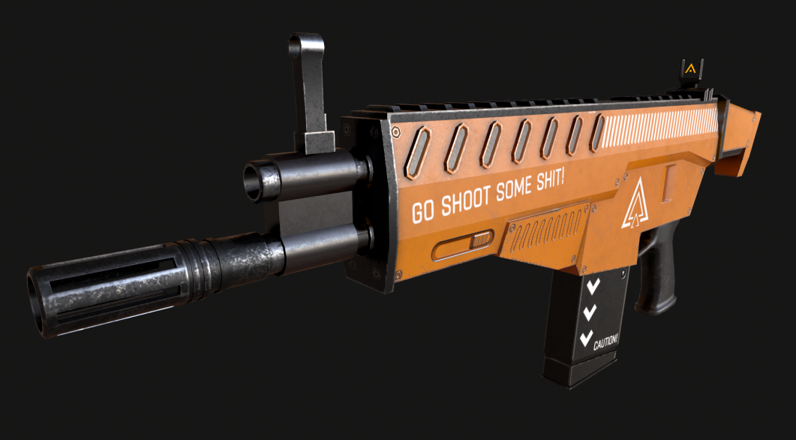
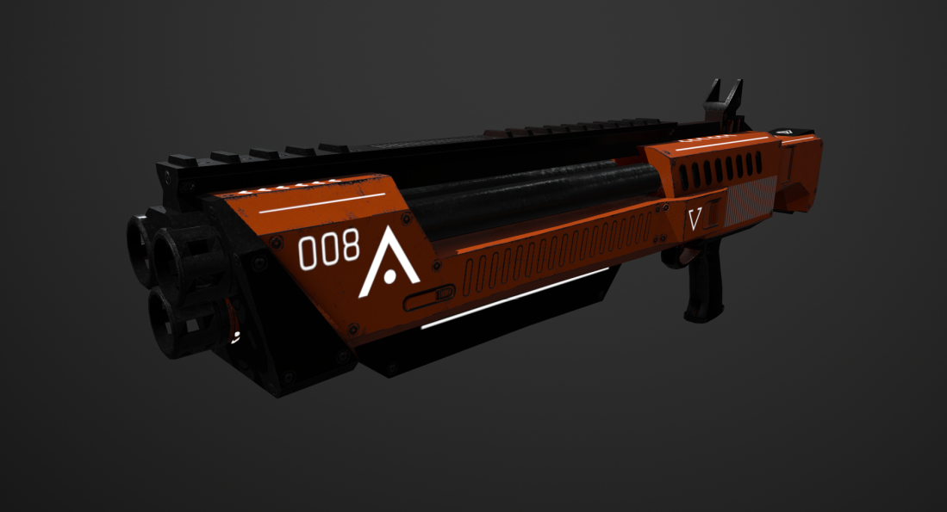
Weapons

Slide 10
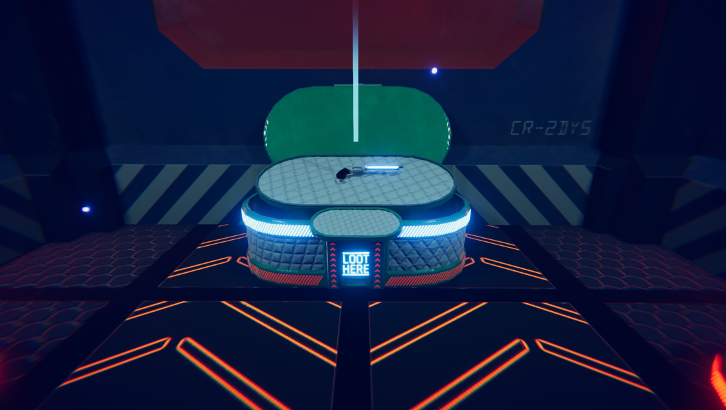
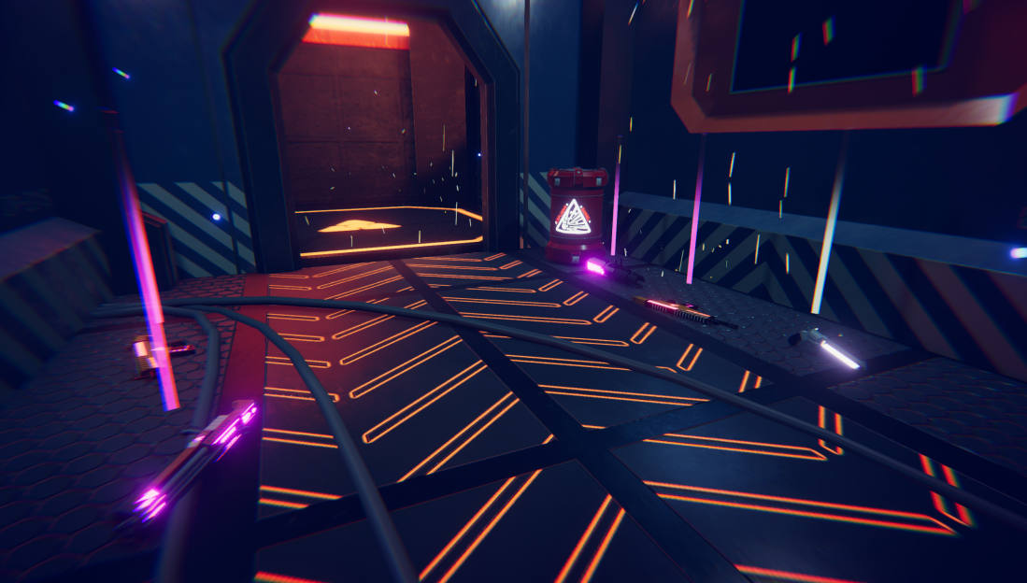

Loot
Randomised weapon tiers

Slide 11
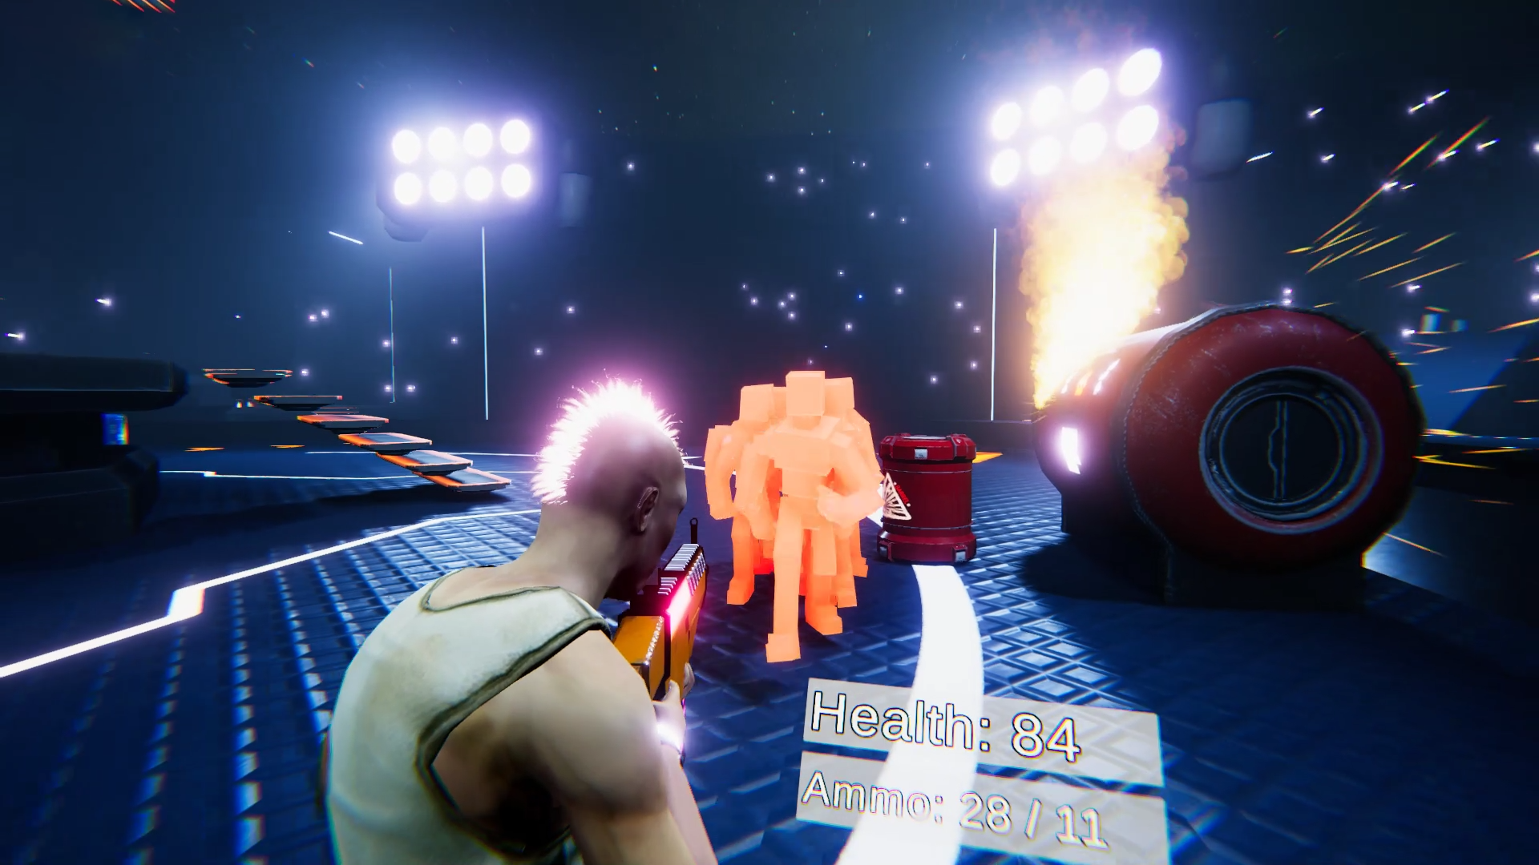
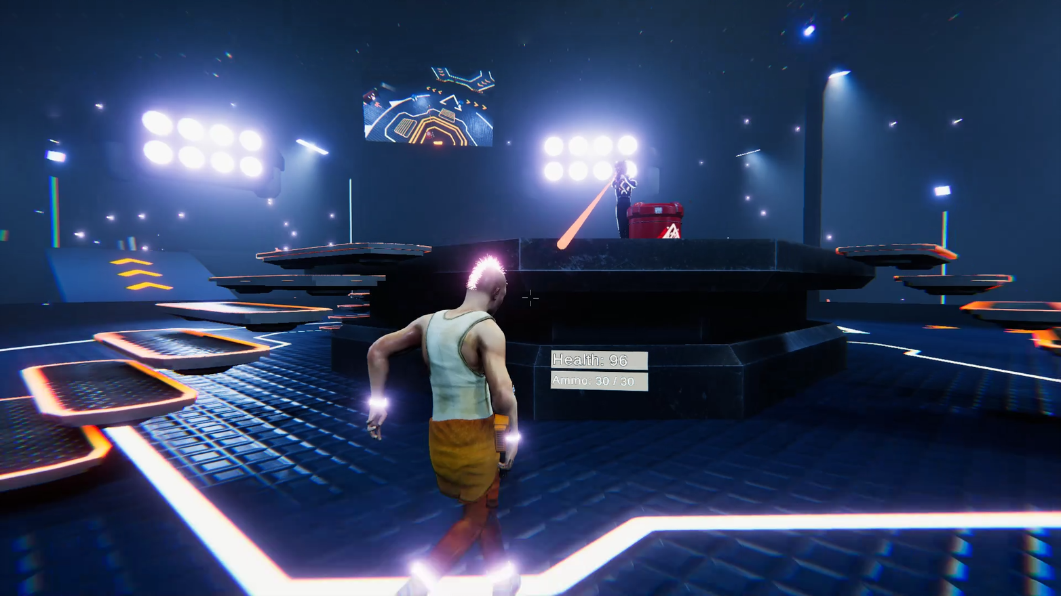
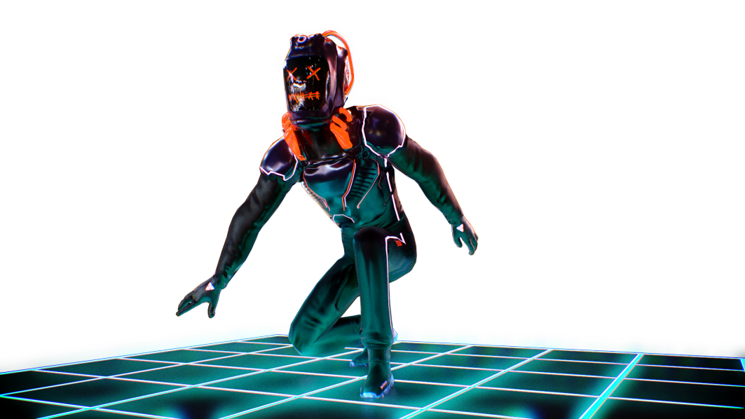
Enemy AI
Horde AI
Ranged Shooters

Slide 12



Networking
Peer to peer UNET
Client-server state synchronization
Testing more tedious
Good structure important for game reliability
State Synchronization
Learning Curve

Slide 13
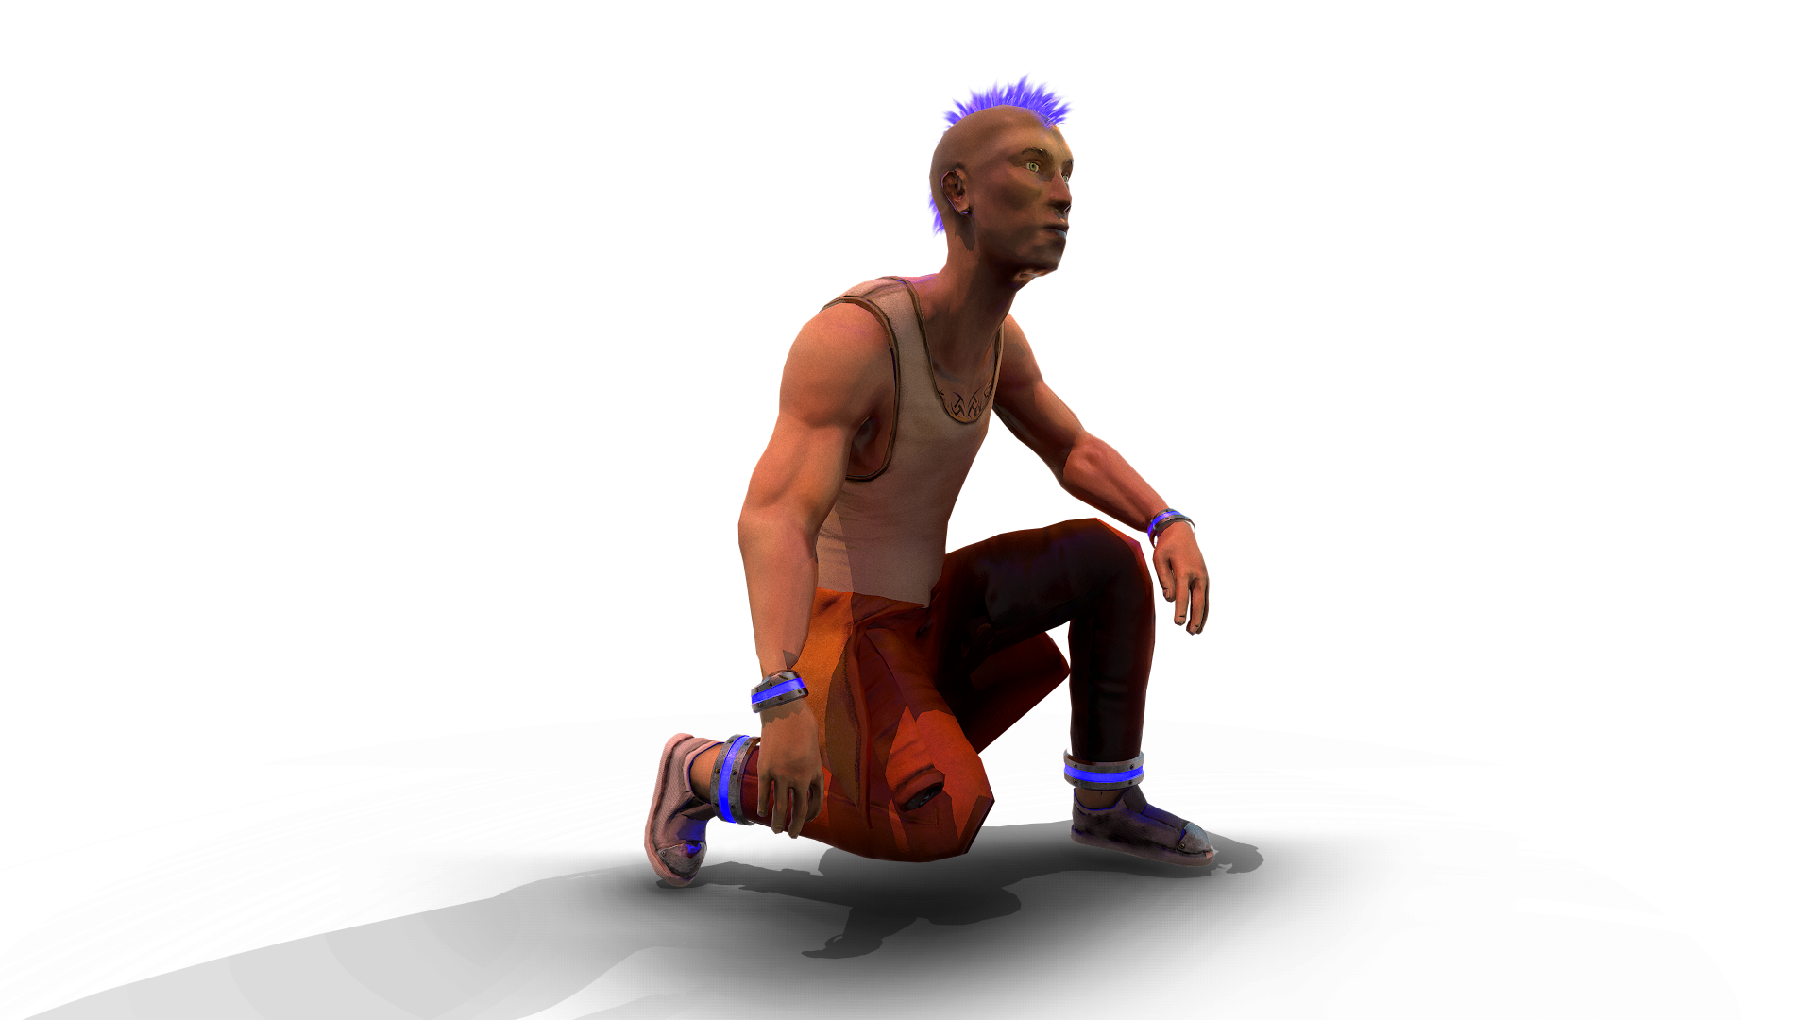
Feature Implementation
Comprehensive feature plan before implementation
Direct and frequent communication with designers
Modular & self-contained implementation approach
Collaborative feature development using GitHub
Implementation structured for networked functionality

Slide 14
GitHub Collaboration
Wouldn’t have been possible without GitHub
Excellent collaboration between programmers and designers
Quick and easy feature merging
Implementation of new assets & scene decoration extremely quick
Automatic project backups allow for rollback in case of disaster

Slide 15
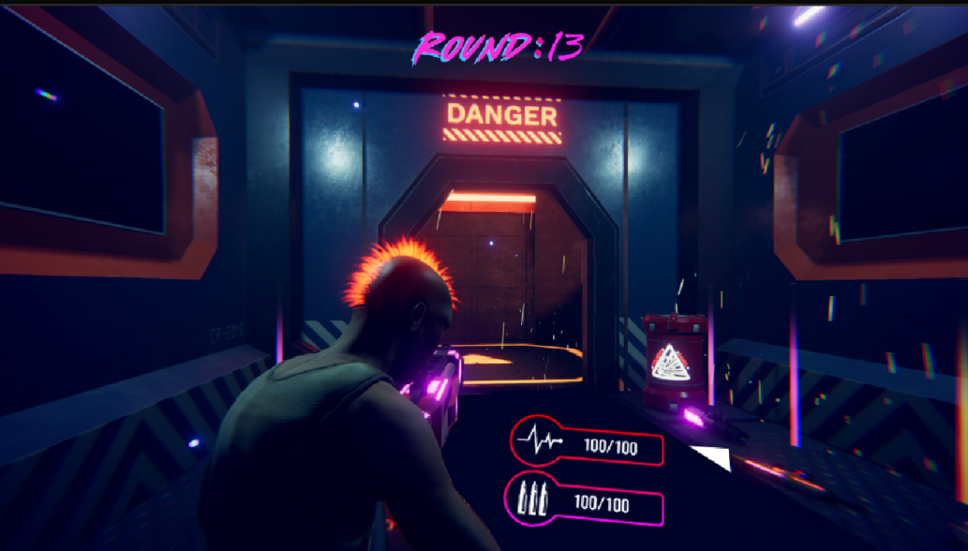
UI

Slide 16
What went well
Great team dynamic.
Full team stayed late every night to finish their tasks.
No major merging conflicts.
Every body took a massive risk in the game concept and design but it paid off.
Achieved playable online game in 5 days.

Slide 17
What went wrong
Uni network issues (McAfee)
Enemy spawning took long
Needed more time to balance game
Steep learning curve for networking
Balance between optimisation and visuals

Slide 18
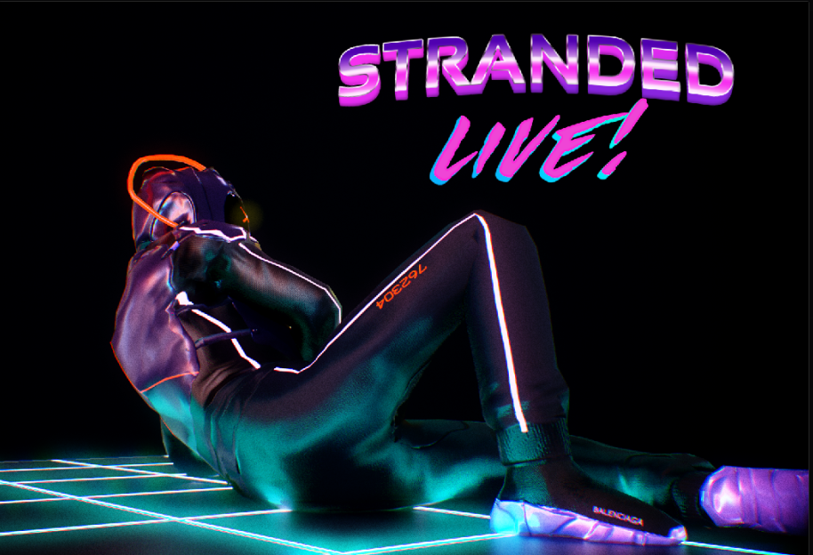
What we learnt
Unity’s new render pipeline
Particle optimisation
Texel Density
Networking
Future Plan
More pick ups
General Polish
More enemy AI

